Slide 1
White Lotus Martha’s Vineyard
“Luxury from Backyard to Beachfront”

Slide 2



The Problem: VIP Transportation
Sicily
Maui
MV
2 Flights, Limo
2 Flights, Limo
1 Flight
Original Location to Venice
Venice to Sicily
Limousine to Resort
Original Location to Honolulu
Honolulu to Maui
Limousine to Resort
Direct Flight – Original Location to Resort
2019

Slide 3
The Solution: White Lotus Charter Flights
SAFETY
Analyze data to select the safest planes
COST
Use cost analysis to remain within $5M budget
COMFORT
Choose planes that will provide experience consistent with White Lotus’ reputation

Slide 4

The Data
SAFETY STATISTICS
COST ANALYSIS
NTSB DATA
VISUALIZATIONS
Data provided by National Transportation Safety Board
Determination of safest aircraft by data analysis
Data from Global Air used to determine best planes to suit our need
Creative visuals to portray findings

Slide 5
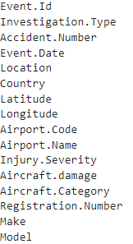
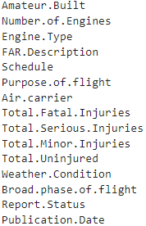
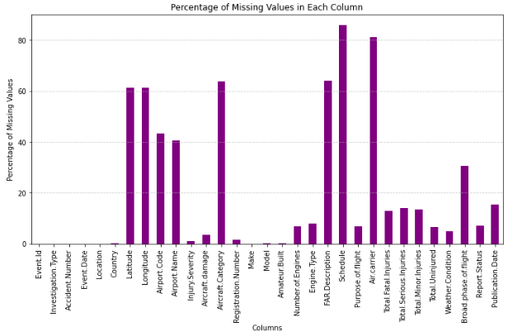
Analysis Part 1 – Zeroing In
ELIMINATING UNNECESSARY INFO
NARROWING DOWN SPECIFIC DATA POINTS
MISSING DATA
Removed data without Make/Model
Cleaned numbers to perform statistical analysis
Impractical
Ungroupable/ Unique
Incomplete
Redundant
Irrelevant
Data only from 1993 on
Professionally built only
USA Only
Private and Small Planes
88,889 Data Points
21,119 Data Points
15,781 Data Points
31 Categories
22 Categories
15 Categories

Slide 6




Analysis Part 2 - Safety Score
Fatality/Injury Score
$$8\left(Fatalities\right)+4\left(Serious Injuries\right)+2\left(Minor Injuries\right)+0(Uninjured)$$
$$1 −$$
$$14(Total Passengers)$$
Plane Damage Score
Overall Safety Score
Fatality/Injury Score
$$2\left(Destroyed\right)+1\left(Substantial\right)+0(Minor)$$
$$1 −$$
$$4$$
Plane Damage Score
Prevention Score
Prevention Score
Safety Score
0.9 (Accident)
1.0 (Incident)

Slide 7
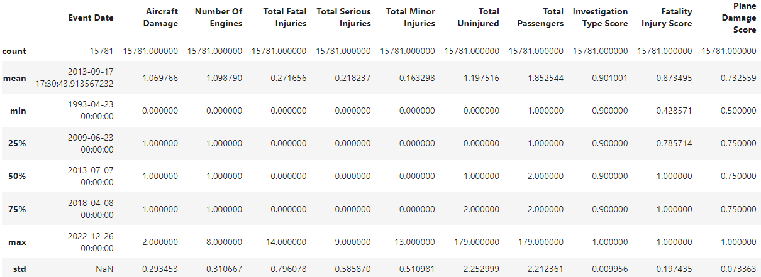

A Look at the Numbers

Slide 8
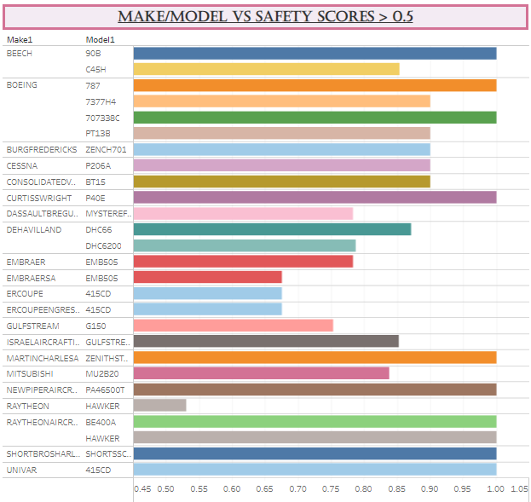
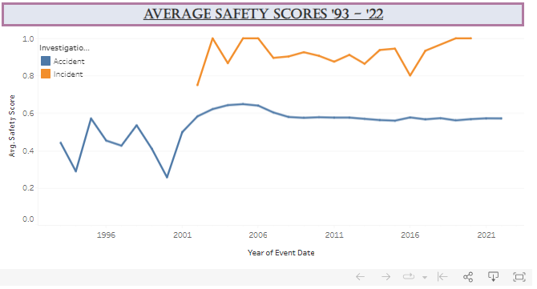
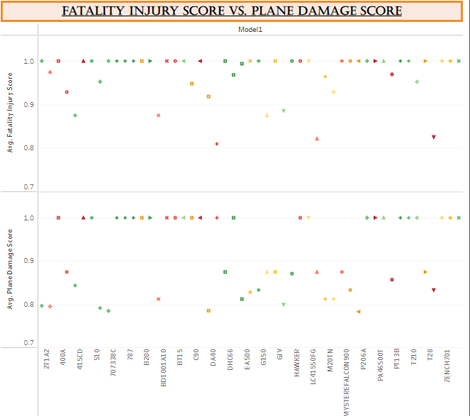
Visualizations – The Safety Score

Slide 9


The Right Choice
COST
Which plane is most financially viable?
CAPACITY
Which plane can carry the largest family/group sizes?
COMFORT
Which plane provides the highest quality experience?

Slide 10
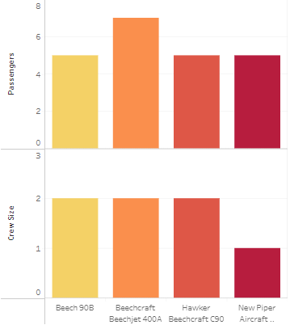
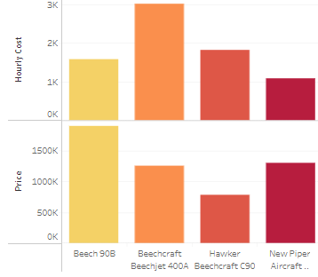
Visualizations – Aircraft Specifications

Slide 11
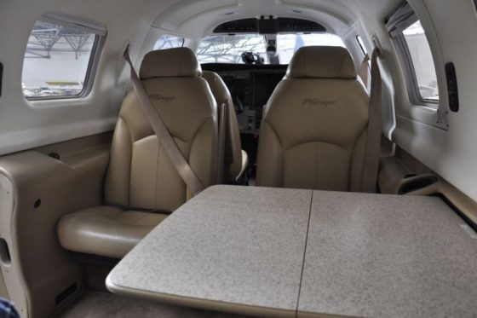
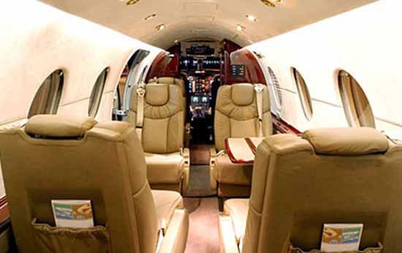
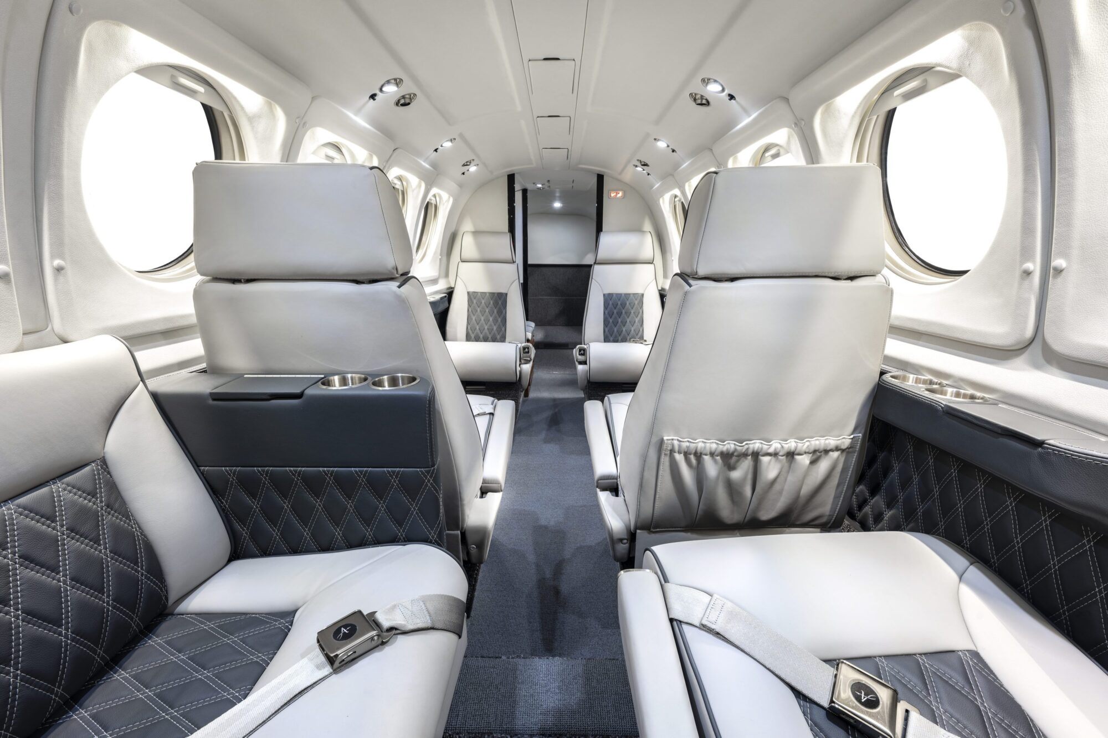
Interiors
New Piper PA-46-500T
Beechjet 400A
Beech 90B

Slide 12
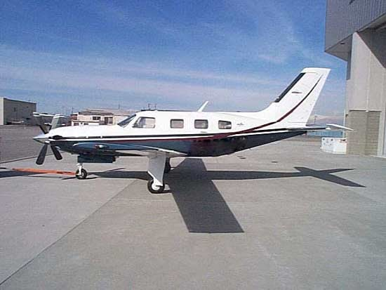
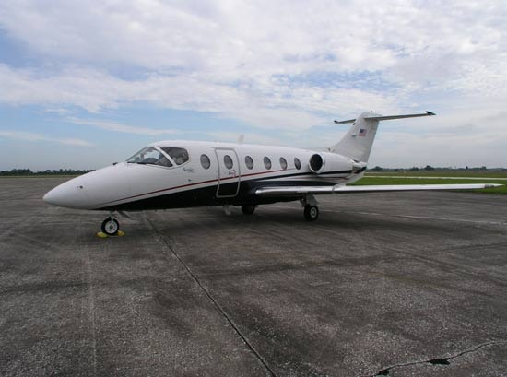
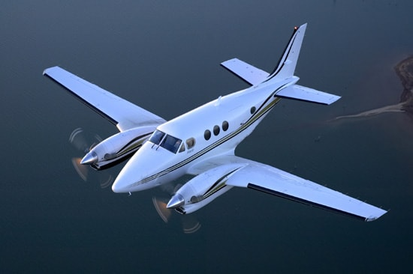
Conclusion – Aircraft Recommendations
Option 1
Option 2
Option 3
Cost-Effective
Largest Capacity
Luxury
New Piper PA-46-500T
Beechjet 400A
Beech 90B
Initial - $1,207,417.66
Initial - $1,256,666.67
Initial - $1,903,750.00
10 Year Cost - $6,219,107.66
10 Year Cost - $14,842626.67
10 Year Cost - $9,057,220.00
25 Year Cost - $13,586,642.66
25 Year Cost - $35,221,566.67
25 Year Cost - $19,787,425.00

Slide 13

Questions?

Slide 14
The Solution: White Lotus Charter Flights
As close to “door-to-door” as vacation can be
EASE
BRAND
White Lotus as the pinnacle of luxury travel
Sit back and relax in your own private space
COMFORT
EXCLUSIVITY
Ensure our VIPs know that they are valued
Enjoy a level of service that only the best can get
LUXURY
INNOVATION
Set trends in the high-end vacation industry
A vacation experience that sets you above the rest
STATUS
MARKETING
Ability to advertise a unique experience

